Slide 1
DADOCK Knowledge Sharing
SEP 2018
Fujitsu (Thailand) Co., Ltd.

Slide 2
Agenda
DevOps Overview
What’s DADOCK
Screenshot & Demo

Slide 3
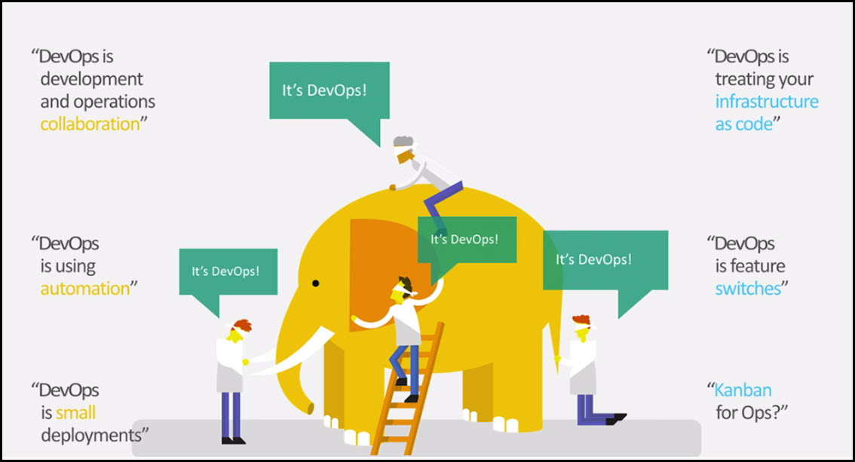
What is DevOps

Slide 4
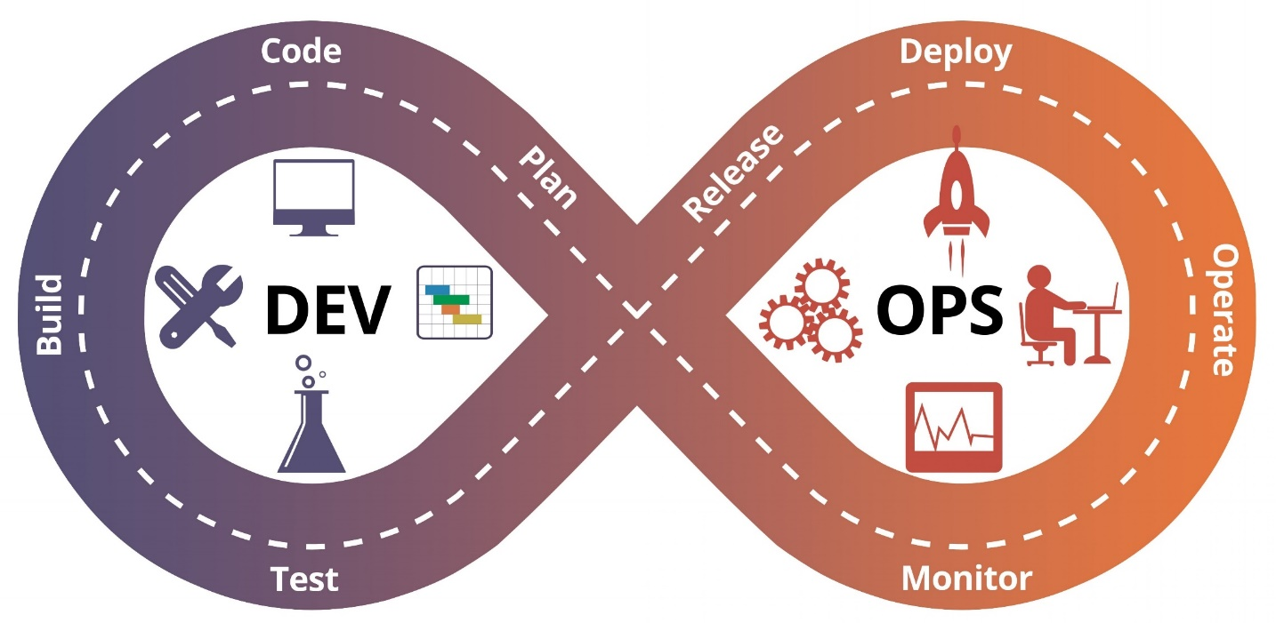
What is DevOps
DevOps : A Culture shift or movement that encourages great collaboration (teamwork)
to faster building,
better quality
More reliability
DevOps is Not
A role, person or orgranization
Something only system admin do
Something only Developers do
Script
Tools
Notes:
From Wikipedia :::
DevOps is a software engineering culture and practice that aims at unifying software development (Dev) and software operation (Ops). The main characteristic of the DevOps movement is to strongly advocate automation and monitoring at all steps of software construction, from integration, testing, releasing to deployment and infrastructure management. DevOps aims at shorter development cycles, increased deployment frequency, and more dependable releases, in close alignment with business objectives.

Slide 5
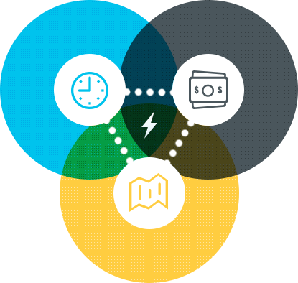
Why DevOps good for TDEM
Time
Reduce Implement Lead Time
Reduce Change Lead Time
Increase competitiveness
Cost
Reduce Implement Lead Time
Reduce Change Lead Time
Increase competitiveness
Quality
Increase System Reliability
Reduce Change Failure Rate
Reduce Human Error

Slide 6
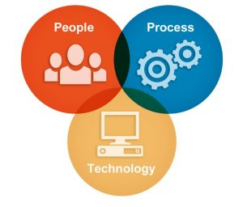
Key Factors To Drive DevOps
People
Collaboration and involvement across team
Process
Monitored
Automation
Copyright 2016 FUJITSU LIMITED
CI/CD Tool
Infra as Code

Slide 7
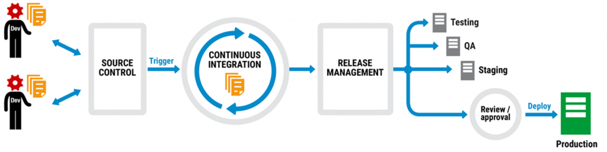
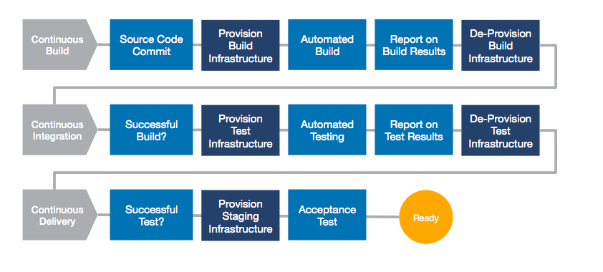
Application Life Cycle

Slide 8
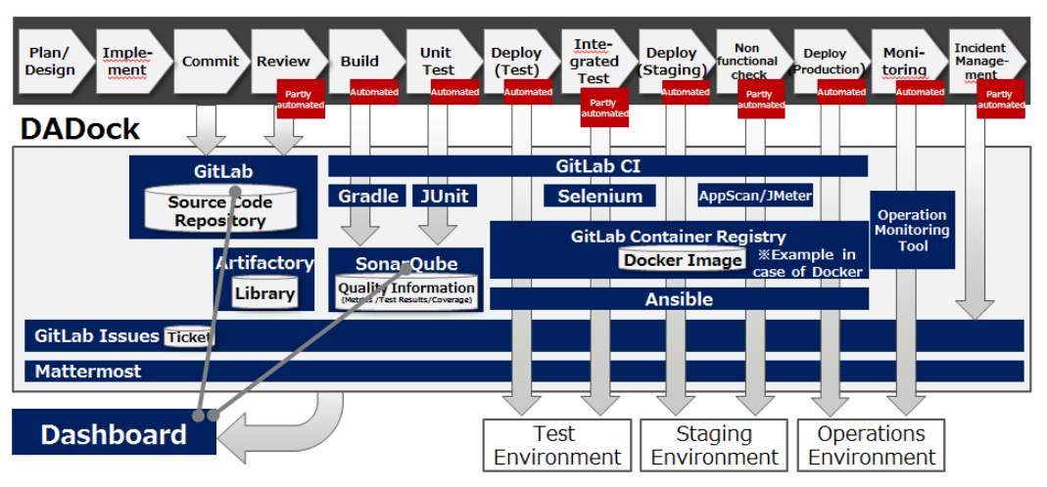
DADOCK Architecture

Slide 9
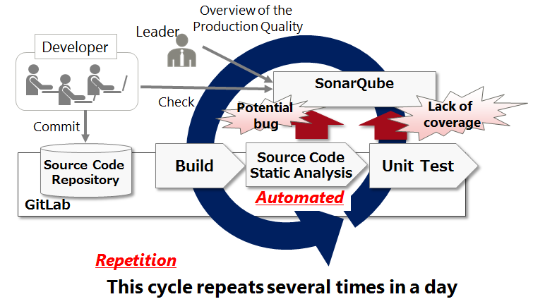


Development Flow with DADOCK
JBOSS
Code
Packaging
App
Deploy
Go-Live
ANSIBLE
JENKINS
INFRA
Remark : For Automate Deployment, can use from DevOps Phase I

Slide 10

DADOCK Component
GITLAB :Manages Git Repository, which is used for the storage of source code and others.
Artifactory : For storage of the build deliverables (Maven repository that is used for storage of JAR and DLL modules)
OpenLDAP : Manages a single account for each OSS tool.
GitlabRunner
DADOCKPortal
OpenLDAP
Ansible
Gitlab
Sonarqube
Artifactory
Mattermost
GitlabRunner
SonarQube : Manages the static analysis results and unit test results of the source code.
MatterMost : A chat type of communication tool.
GITLAB Runner :Connected to GitLab, and executes automatically the pipeline processes of build, deploy, etc. of development assets.

Slide 11



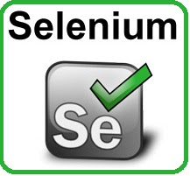
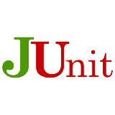
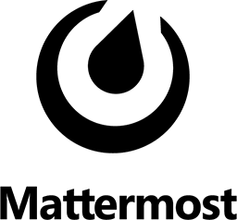
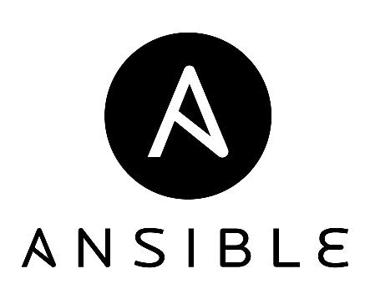
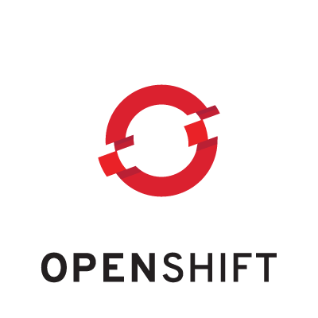
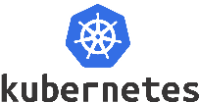

DevOps Tool Definition
Repository Tool
Quality Control Tool
Gitlab : Source Code Repository
-
SonarQube : Source Code Quality Control
Selenium & Junit :
Automate Testing
Mattermost : ChatEngine
JFrog : Artifact Repository
CM & CI/CD Tool
Environment Management Tool
Ansible : Configuration Management
Configuration Management
Openshift & Kubernetes
Container management tool
Jenkins : CI/CD & Pipeline Management Tool
Notes:
Nexus
Centralized repository for managing all popular component formats
Single source of truth for all binaries and build artifacts.
Gain insight into component security, license, and quality issues.
=========================================================================
Vagrant is an open-source software product for building and maintaining portable virtual software development environments,^{[4]} e.g. for VirtualBox, Hyper-V, Docker containers, VMware, and AWS which try to simplify software configuration management of virtualizations in order to increase development productivity. Vagrant is written in the Ruby language, but its ecosystem supports development in almost all major languages.
For Developers
If you are a developer, Vagrant will isolate dependencies and their configuration within a single disposable, consistent environment, without sacrificing any of the tools you are used to working with (editors, browsers, debuggers, etc.). Once you or someone else creates a single Vagrantfile, you just need to vagrant up and everything is installed and configured for you to work. Other members of your team create their development environments from the same configuration, so whether you are working on Linux, Mac OS X, or Windows, all your team members are running code in the same environment, against the same dependencies, all configured the same way. Say goodbye to "works on my machine" bugs.
»For Operators
If you are an operations engineer or DevOps engineer, Vagrant gives you a disposable environment and consistent workflow for developing and testing infrastructure management scripts. You can quickly test things like shell scripts, Chef cookbooks, Puppet modules, and more using local virtualization such as VirtualBox or VMware. Then, with the same configuration, you can test these scripts on remote clouds such as AWS or RackSpace with the same workflow. Ditch your custom scripts to recycle EC2 instances, stop juggling SSH prompts to various machines, and start using Vagrant to bring sanity to your life.
»For Designers
If you are a designer, Vagrant will automatically set everything up that is required for that web app in order for you to focus on doing what you do best: design. Once a developer configures Vagrant, you do not need to worry about how to get that app running ever again. No more bothering other developers to help you fix your environment so you can test designs. Just check out the code, vagrant up, and start designing.
=========================================================================
ANSIBLE
Saving a huge amount of time when deploying a new server
Ansible is very human readable for people who know nothing about Ansible
Ansible will SSH into the desired hosts to do its job. NO AGENTS!
Configuration files deployed by your Ansible playbooks are all kept in source control. Easily go back and see past changes.
If the only team member who knows Ansible leaves, the hosts can still be managed normally by hand as always.
=========================================================================

Slide 12
SCREENSHOT

Slide 13
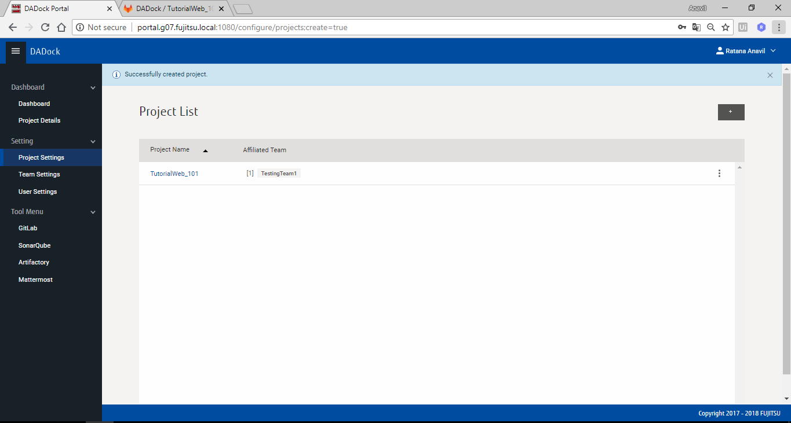
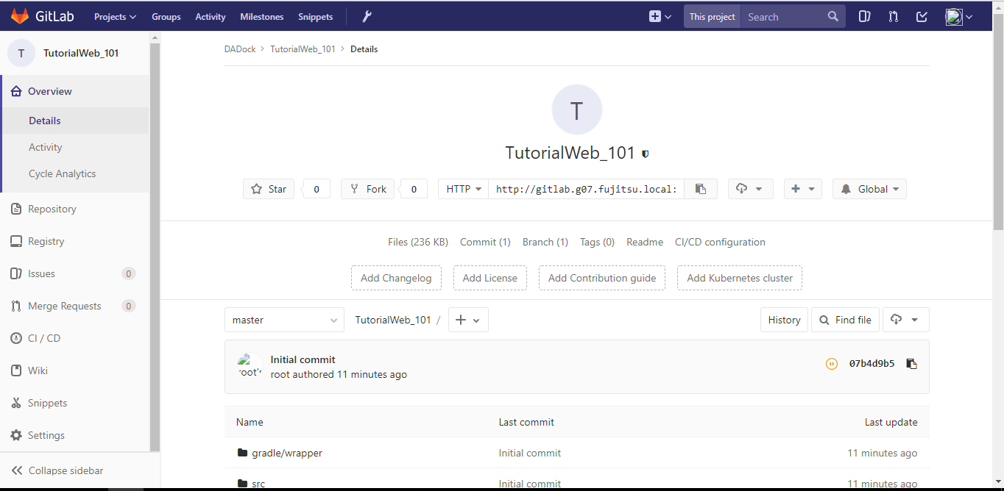
DADOCK Portal Screen
Project created from portal Link with Gitlab webGUI.
From Portal, can link to each
DevOps component
- Gitlab/SonarQube/Artifact and ChatEngine.

Slide 14
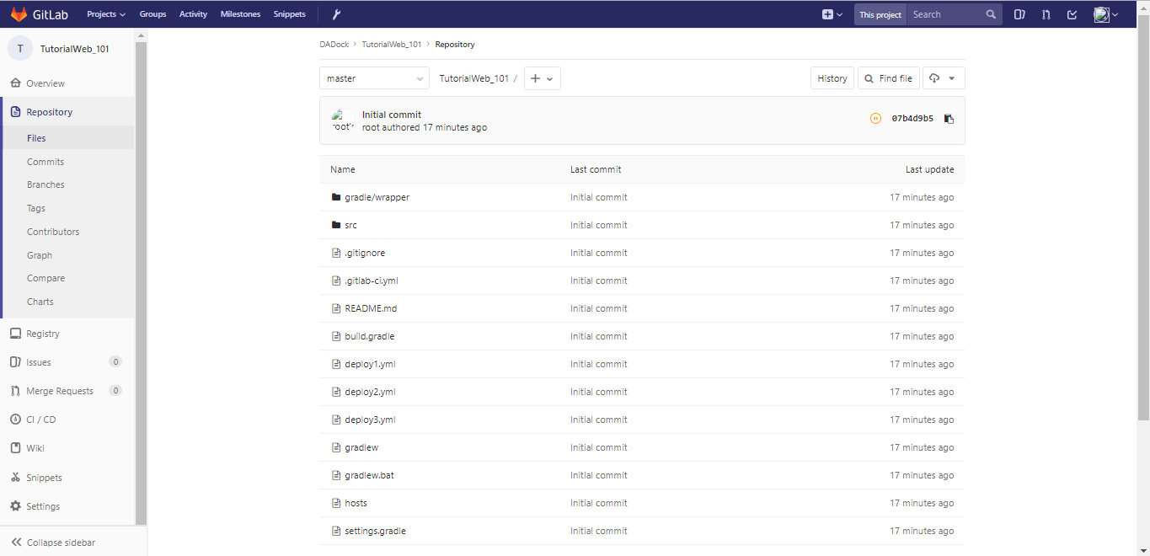
Gitlab ScreenShot
Project Template, which created from DADOCK, include necessary files for Development project,
Such as :
- gradle file for built/pack source
- deploy.yml for deploy to App server.
- Hosts file

Slide 15
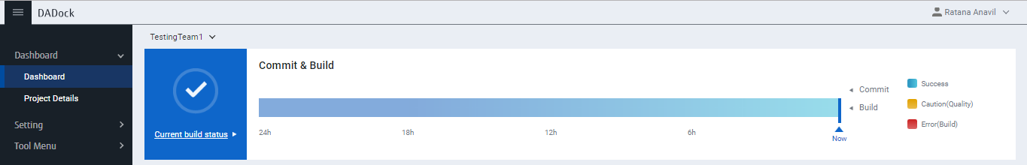
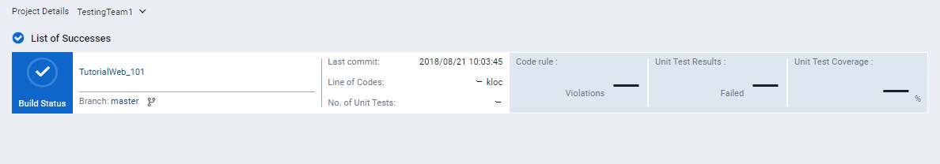
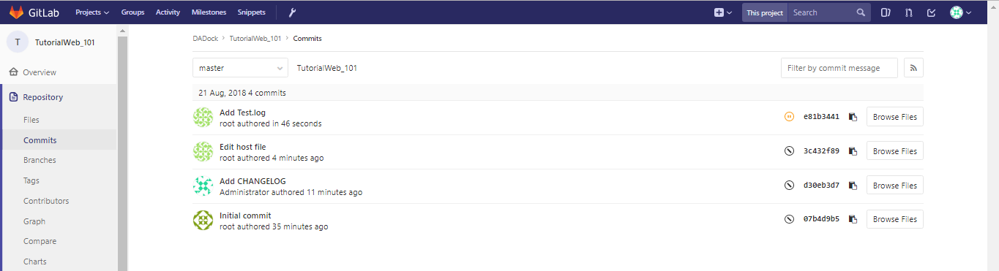
Project Details ScreenShot
From portal screen, can drill down to project details,
Can link to Gitlab to see any file changed in git repository

Slide 16
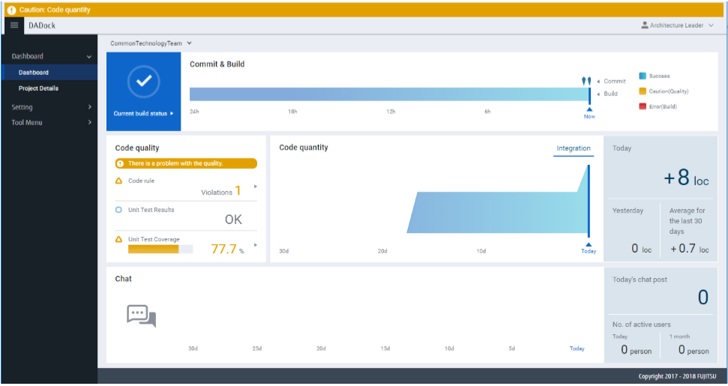
SonarQube for Code Quality
After Build code, can see Code Quality, from DADOCK portal screen
* Code Quality Rules are predefine in SonarQube

Slide 17
Dadock Demo
DEMO

